Slide 1




Lecture-3
Fundamentals -II
Programming Fundamentals contd..
Kartik Mathur

Slide 2
Any doubts?

Slide 3
Brain Teasers?
3

Slide 4
BT–5: Circular Jail Cell
4
There is a circular jail with 100 cells numbered 1-
100. Each cell has an inmate and the door is locked. One night the jailor gets drunk and starts running around the jail in circles. In his first round he opens each door. In his second round he visits every 2nd door (2,4,6---) and shuts the door. In the 3rd round he visits every 3rd door (3,6,9---) and if the door is shut he opens it, if it is open he shuts it. This continues for 100 rounds (i.e. 4,8,12 ---; 5,10,15 -
--;---; 49,98 etc.) and exhausted the jailor fal s
down.
How many prisoners found their doors open
after 100 rounds?

Slide 5
BT–6: Greedy Pirates
A pirate ship captures a treasure of 1000 golden coins. The treasure has to be split
among the 5 pirates: 1, 2, 3, 4, and 5 in order
of rank. The pirates have the following important characteristics: infinitely smart, bloodthirsty, greedy. Starting with pirate 5 they can make a proposal how to split up the treasure. This proposal can either be accepted or the pirate is thrown overboard. A proposal is accepted if and only if a majority of the pirates agrees on it. What proposal should pirate 5 make?

Slide 6
BT–7: Infinite Quarter Sequence
You are wearing a blindfold and thick gloves. An infinite number of quarters are laid out before you on a table of infinite area. Someone tel s you that 20 of these quarters are tails and the rest are heads. He says that if you can split the quarters into 2 piles where the number of tails quarters is the same in both piles, then you win all of the quarters. You are allowed to move the quarters and to flip them over, but you can never tell what state a quarter is currently in (the blindfold prevents you from seeing, and the gloves prevent you from feeling which side is heads or tails). How do you partition the quarters so that you can win them all?

Slide 7
BT–8: Daughters’ Ages
Local Berkeley professors Dr. X and Dr. Y bump into each after a long time.
X Y
X Y
hey! how have you been?
great! i got married and i have three daughters now
really? how old arethey?
well, the product of their ages is 72, and the sum of their ages is the same as the number on that building over there
right, ok ... oh wait ... hmm, i stil don't know oh sorry, the oldest one just started to play the piano
wonderful! my oldest is the same age!
Y X
Y
How old are the daughters?

Slide 8
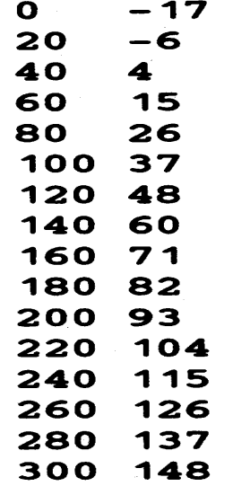
Warm up!
Write a program which takes initial value, final value and a step value and prints a table for Fahrenheit to Celsius using formula - C =(5/9)(F
– 32)
E.g: For initial 0, final 300 and step 20 output is

Slide 9
Warm up!
Write a program which takes and character input and check that whether a number is an Upper Case or a Lower Case.
A to Z – Upper Case a to z- Lower Case

Slide 10
Square root of a given number?

Slide 11
Sizeof( ) operator ?
10

Slide 12
Constants
11
C++ has two types of constants
□ Literals
i. Integer [ 212, 215u,0x4b,077, 30ul, 75L)
ii. Floating [3.14, 31459E-5]
iii. Boolean [ true,false]
iv. Character [ ‘a’, ‘\n’, ‘\t’, ‘\\’, ‘\’’ ]
v. String [ “Coding Blocks”]
Symbolic Constants
#define preprocessor(no space is occupied, not compiled, can’t be changed in main)
const keyword

Slide 13
Type conversion!
12
Implicit –Based on the operator and operands
Explicit –(new type)expression

Slide 14
Operators we have seen
13
Unary [ +,-]
□ Arithmetic [ +,-, /, *,%]
Brackets [ () ]
Assignment [ =]
□ Relational [ ==,!=, >,<,>=, <=]
Logical Operators [ &&, ||, ! ]
PS - 1: Relational Operators and Logical Operators always Evaluate to 0 or1
PS –2: For logical evaluation any non-zero value is true.
PS - 3: Evaluation of a logical expressions stops as soon as the final value is known.

Slide 15
Some more operators!
Arithmetic –[ ++, --]
Bitwise Operators –[ &, | , ~,^, <<,>>]
Compound assignment operators – [ +=, *=, /=, %=,&=, |=, ^=,<<=,>>=]

Slide 16
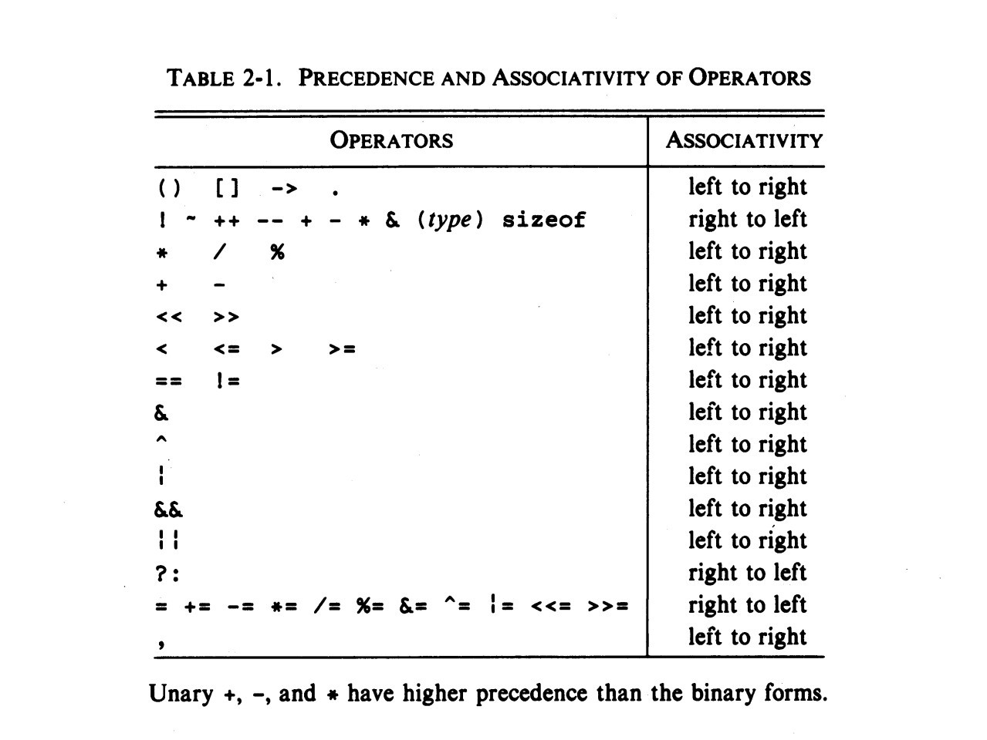
Precedence & Associativity

Slide 17
16
Another type of a loop!
for(initialization;condition;step) {}

Slide 18
Lets convert some problems to use for
Print all prime numbers between 2 to N
Reverse a number
Print the following pattern
1
0 1
1 0 1
0 1 0 1
1 0 1 0 1

Slide 19
To alter normal flow of a loop
break;
continue;

Slide 20
Easy?
In the below code, change/add only one character and print ‘*’ exactly 20 times.
int main() {
int i, n =20;
for (i =0; i <n; i--)
cout <<“*”; return 0;
}

Slide 21
Time to try?
20
Given an integer n, count number of bits set ( number of bits which are 1) in it.
Given N,Print following pattern (FOR N =5)
ABCDEEDCBA ABCDDCBA ABCCBA ABBA
AA

Slide 22
What is next class about?
21
Some more basic constructs
Arrays

Slide 23
Thank You!
Kartik Mathur kartik.mathur@codingblocks.com
+91-9560196180

